Slide 1
Lab 10: Comparing Two Population Means with Dependent Samples
STAT 201: Elementary Statistics

Slide 2


Slide 3
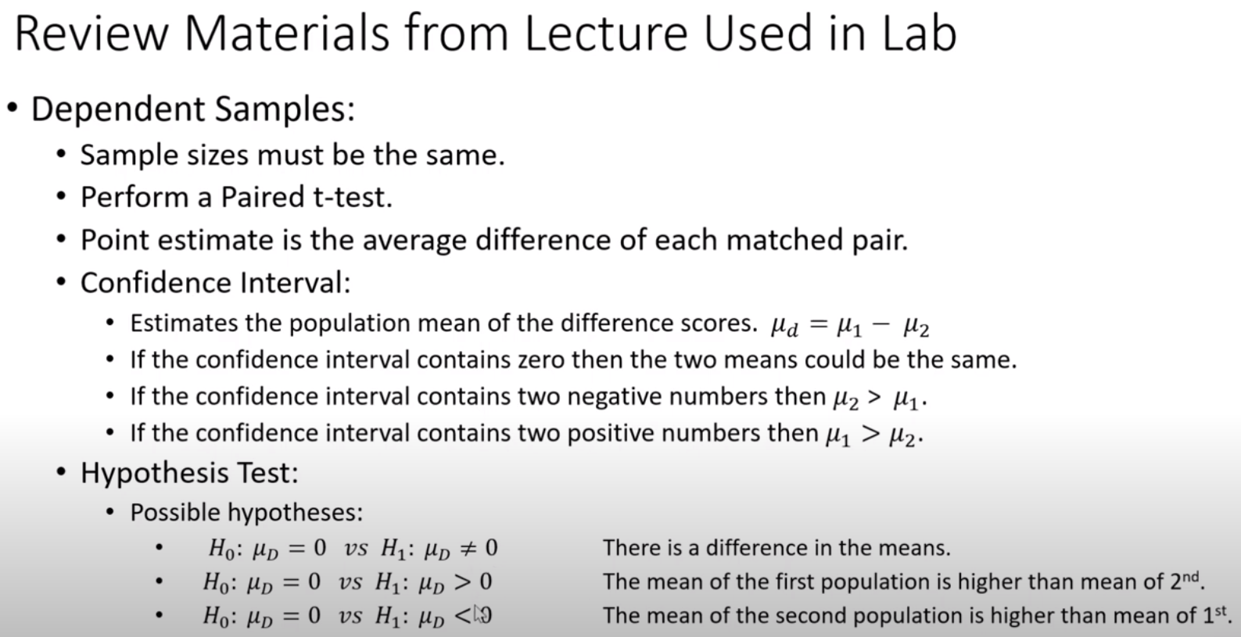

Slide 4
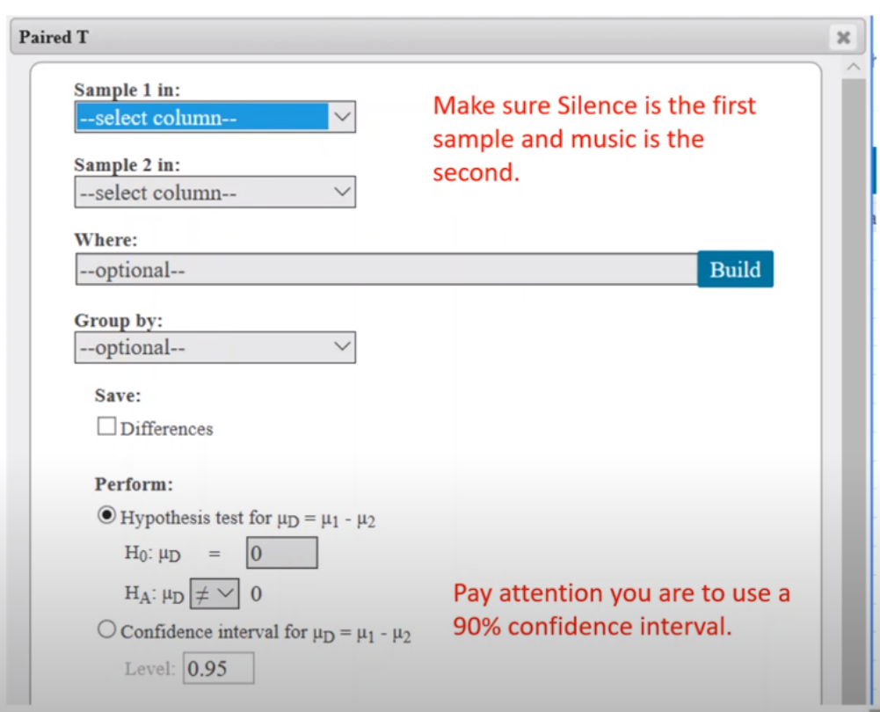
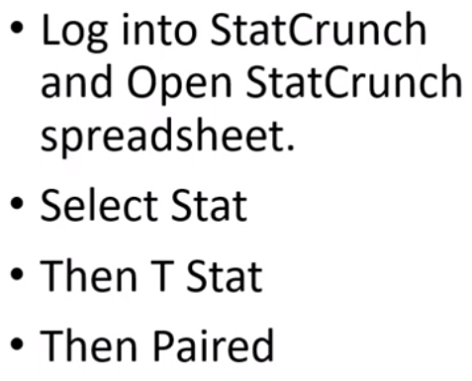

Slide 5
